Slide 1
DNN LOVES JENKINS FOR CONTINUOUS INTEGRATION
Steffen & Simon

Slide 2
About us

Slide 3
Agenda
Why automation?
What is Jenkins?
Best practices
Real life example

Slide 4
Story of software development
Cloud
Internet
?
Agile Development
OOP
Software Crisis
Komplexity
Complexity
1960
1980
2000
2010

Slide 5
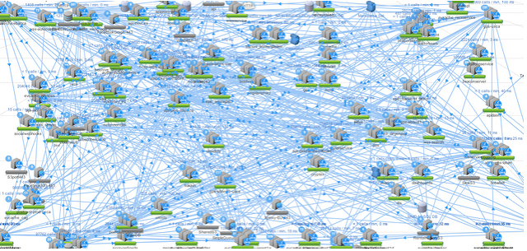
Our pain points of complexity

Slide 6
What do we need?
Lean ways so solve problems
Automation to deliver iterative software
BIGGER, BETTER, FASTER, CHEAPER

Slide 7
Benefits of automation
Bigger
Deployment
Rollout and deliver software automated to large scale environments (e.g. AWS)
Control
Gain control over a huge number of components and systems

Slide 8
Benefits of automation
Better
Project Management
Reduces risk of cost, schedule and budget
Improve Quality
Can help to improve your quality of software and developer skills

Slide 9
Benefits of automation
Faster
Development
Detect problems of development early and act on them before they get bigger
Testing
Continuous automated testing

Slide 10
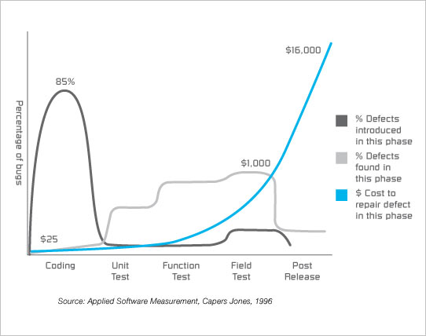
Benefits of automation
Cheaper
Costs of Integration
Integration is expensive. Efforts increase exponentially with number of components and time since last integration
Bugs
Fixing bugs late is costly

Slide 11
How to automate?

Slide 12
What is Jenkins?
An extendable open source continuous integration server
Easy to use and configure
Has many plugins to customization
Distributed build features
Dynamic client server model
Independent from programming language

Slide 13
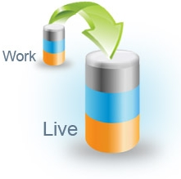
What is Jenkins?
Build
Ensures the project compiles on every target platform
Improved flexibility with configuration profiles
Database integration
Keeps code and DB in sync
(Re)creation of DB and mock data

Slide 14
What is Jenkins?
Code inspection
Improves the overall quality of software and the developers skills
Enforces best practices
Get build reports and code metrics
Continuous deployment
Software can be released anytime, nearly anywhere
No more “works on my machine”

Slide 15
First steps with Jenkins
1.
SCM trigger
Build Server
2.
MSBuild
Build pipeline
3.
Unit test /
UI test
Web Server
4.
Copy job

Slide 16
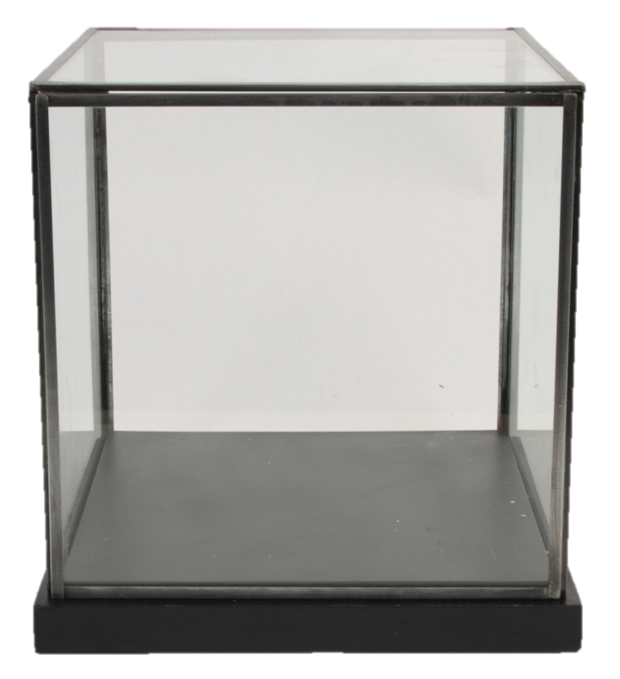
First steps with Jenkins
Showcase

Slide 17
Best practices
Clean builds from source code control
Email notification for developers to spread project status
Tight coupling with issue tracking systems (e.g. JIRA)
Use steps for every build pipeline for quality levels and error reporting

Slide 18
How about a real life example
Customer self service portal DNN 7 //
GIT SCM //
3 systems staging environment (dev, stage, prod) //
Running on AWS //
Developer team size 5-10
Use cases
Build and deploy from git
Config transformation profiles
Packaging with nuget

Slide 19
Real life
Notes:
Build pipeline
Build → Code Inspection →
Unit Test → Code Documentation →
Dev Deployment → Integrations Tests →
Aprovement -> Stage Deployment
Next: Code inspection

Slide 20
Real life
Notes:
Count: Todo
Next: Result of build job -> Artefact

Slide 21
Real life
Notes:
Next: Questions
Job

Slide 22
Questions?

